Slide 1


From Blog To E-Book
ICN Research & Innovation, October 2016

Slide 2
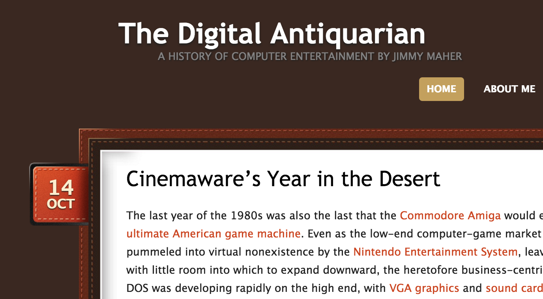
Motivation
You all know how it goes
A podcast I like recommended a blog
The blog was really well written
…but too long to read comfortably

Slide 3
Motivation
…but too long to read comfortably
I wanted to read it on my Kindle
I had experience with e-book formats
Spoiler: they are webpages
So really it’s webpages to webpages
Should be easy enough to code :)

Slide 4

The E-Books Link
Demo

Slide 5







Agenda
E-Book Formats
Technology Choices
Code and Demo

Slide 6

<EBookFormats>
Notes:
Note:
Use this slide as divider page.

Slide 7
Four Big E-Book Formats Link
Output Dimensions Fixed?
Y
N
Full Typesetting at Compile Time
Dynamic Layout with HTML/CSS
Comic Book?
Amazon Device?
Y
N
Y
N
No Standard Only images
Open Format Vector Content
Open Format Allow Editing
DRM Lock-In
.cbr .cbz .cb7
.prc .mobi .azw .azw3
.pdf .ps
.epub
Notes:
Advantages of dynamic layout include:
Change font size, margins at runtime
Allow landscape/portrait mode

Slide 8
Proprietary Mobipocket Format Link
2000
Mobipocket is founded in France
Reader software targeting mobile OSes
Palm, Symbian, Windows…
2005
Amazon acquires Mobipocket 2.5mil
2007 (1st gen)
First Kindle uses .mobi
2009 (2nd gen)
Second Kindle uses .azw
2011 (4th gen)
Kindle Format 8, i.e., .azw3
2015 (7th gen)
Kindle Format 10, i.e., .kfx
.prc | Original Mobipocket
.mobi | Renamed by Amazon
.azw | New DRM scheme
.azw3 .kf8 | HTML5, CSS3 support
.kfx | New DRM scheme Hyphens, kerning, ligatures support
To help authors, Amazon always released an ePub to Kindle converter kindlegen (not yet for .kfx)

Slide 9
Open EPub Format Link
International Digital Publishing Forum (IDPF) publishes ePub 2.x, 3.x
Explicitly as a spec
Implicitly as a tool epubcheck
Epubcheck
Checks that your files are valid and compresses them into .epub file
File structure
mimetype
META-INF
| container.xml
OEBPS
| content.opf
| content
| titlepage.xhtml
| nav.xhtml
| legacy-nav.ncx
| style.css
| …
| assets
| cover.jpg
| …

Slide 10
</EBookFormats> Questions? <TechnologyChoices>
Notes:
Note:
Use this slide as divider page.

Slide 11
Work packages
Scrape blog website
Parse and Convert
Sanitize all XHMTL bugs
Reorganize into ePub structure
Make asset links local
Create navigation
Testing
Design
Make covers
Decide on book chapters
Write jacket blurb
Make two editions
With and without comments
Integrate download into blog site
Expected
Unexpected

Slide 12
Language and Dependencies
Language
Performance not critical
Lots of standard problems
C#
Javascript
Python
Java
Go
…
Dependencies
Blog scraping
urllib2 (standard)
requests (pure python lib)
HTML parsing
elementtree (standard)
beautifulsoup (pure python lib)
lxml (lib linking libxml2)
Kindlegen post-processing
kindlestrip (pure python script)

Slide 13
</TechnologyChoices> Questions? <CodeAndDemo>
Notes:
Note:
Use this slide as divider page.

Slide 14
Code &
Demo

Slide 15
</CodeAndDemo> Questions?
Notes:
Note:
Use this slide as divider page.

Slide 16
Ad: Handmade Con
Handmade Con 2015
Tommy Refenes (Super Meat Boy)
Mike Acton (Ratchet and Clank)
Pat Wyatt (Guild Wars)
Jonathan Blow (Braid, The Witness)
Ron Gilbert (Monkey Island, Thimbleweed Park)
Handmade Con 2016, Nov 19th
Fabian Giesen (RAD Game Tools)
Jeff Roberts (RAD Game Tools)
Jason Gregory (Naughty Dog)
Chris Butcher (Bungie)
Marco Koegler (Blizzard)
Emily Scherb (Pure Motion)
Chris Green (Valve)
John Miles
Sean Barrett (RAD Game Tools)
Chris Hecker (definition six)
Tommy Refenes (Team Meat)
Pat Wyatt (Amazon)
Jonathan Blow (Thekla)
Ron Gilbert (Terrible Toybox)

Slide 17
Thank You!
Contact information:
Dr. Richard Lindner
ICN Research & Innovation
+49 6227 78-57156

